Slide 1






Virtual Care Assistant
from home
Presented By :
Shay Sason 208849232
Gabrielle Maor 322549858

Slide 2

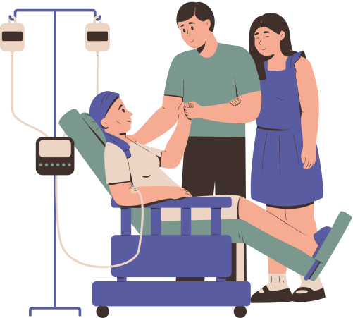
Project Description
Project
Home-hospitalization monitoring: predict patient status from vitals & text
Task
Multi-modal classifier for Normal / Improvement / Deterioration
Fuse structured vitals + free-text complaints
Data
620 patient-episodes (HR, SpO₂, Temp, RR + free text)
Preprocessing: impute & normalize vitals, TF-IDF & RandomForest or BERT embeddings
Evaluation
Stratified 5-fold CV
Metrics: Accuracy, Macro-F1
Baseline vs. Deep-Learning comparison

Slide 3

Prior Art
Source / Title (Year) | Approach / Model | Data (size) | Metrics | Results
“Deep learning for early warning of inpatient deterioration” (Nature Digit. Med., 2021) https://did.li/1otx5 | LSTM with attention on vital-sign time-series | 2,100 patient episodes (minute-by-minute vitals) | AUC, Macro-F1 | AUC 0.87, Macro-F1 0.71; attention maps showed SpO₂ drops and HR spikes as strongest early-warning signals; model predicts deterioration up to 12 h in advance.
“Fusion of clinical notes and vitals using BERT + MLP” (J. Gen. Intern. Med., 2023) https://did.li/fAVaa | BERT encoder on free-text notes + MLP head for vitals | 800 home-hospitalization episodes | Accuracy, Precision, Recall | Accuracy 0.76; Precision 0.74; Recall 0.72; text+vitals fusion improved Macro-F1 by 8 pp over vitals-only baseline; ablation confirmed synergy of both modalities.
“Combining vital signs and free-text for deterioration detection” (PMC, 2019) https://did.li/dR7CN | TF-IDF vectorization on clinical notes + LightGBM | 1,200 inpatient stays (notes + vitals) | ROC-AUC, Sensitivity, Specificity | ROC-AUC 0.79; Sensitivity 0.81; Specificity 0.75; top predictive text tokens included “pain,” “breathlessness,” “fatigue”; combining features outperformed single-modality.

Slide 4



Market Solutions
Examples of Existing Market Solutions:
Current Health (USA)
AI-powered remote monitoring platform that combines wearable sensors and patient-reported data to detect early clinical deterioration. www.currenthealth.com
Datos Health (Israel)
Automated remote‐care system integrating physiological signals and patient self-reports to personalize treatment plans using AI. www.datos-health.com
Our Approach:
Active, Proactive Classification
Real-time prediction of patient status (Stable / Improving / Deteriorating), not just passive monitoring.
Fusion of Free-Text Reports & Vitals
Applying NLP to unstructured patient complaints and descriptions alongside physiological measurements.
Clinical Decision Support Focus
Prioritizing patients who need immediate intervention and aiding medical teams on the ground with rapid, data-driven decisions.

Slide 5


Steps
1.Preprocessing:
Dataset:
home-hospitalization episodes
Vitals
Impute missing (median)
Smooth sensor spikes (median filter) & cap extreme outliers (e.g. HR <40 or >180, SpO₂ <80)
Normalize with StandardScaler
Text
Lowercase, strip punctuation & stopwords
Option A: TF-IDF vectorization
Option B: extract contextual embeddings (e.g. BERT)
3.Model Comparison
Vitals-only (baseline)
Logistic Regression
Random Forest
Text-only
TF-IDF → Logistic Regression
Frozen BERT embeddings → Random Forest
Classical Fusion
[TF-IDF + Vitals] → Random Forest
Deep-Learning Fusion
Fine-tune BERT on text + MLP head on vitals features
2.Labeling
Classes:
Normal (~60%)
Improvement (~25%)
Deterioration (~15%)
Preparation:
Ensure correct mapping of status codes
Stratify splits to preserve class ratios
4.Evaluation
Stratified 5-fold CV
Metrics: Accuracy | Macro-F1 |
Ablation studies: compare
Vitals-only
Text-only
Combined modalities

Slide 6
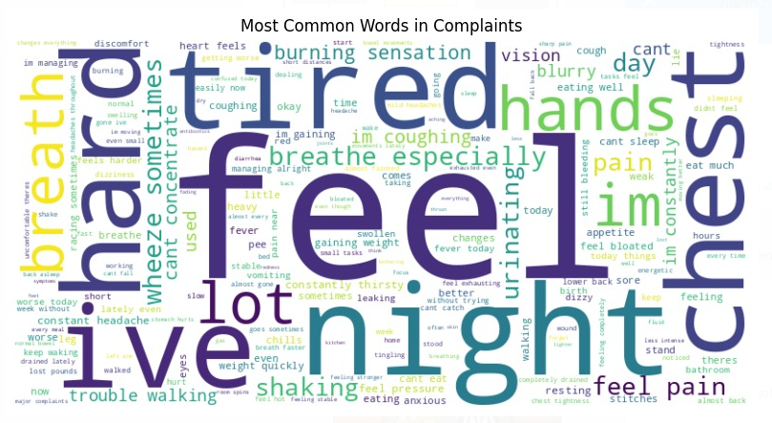
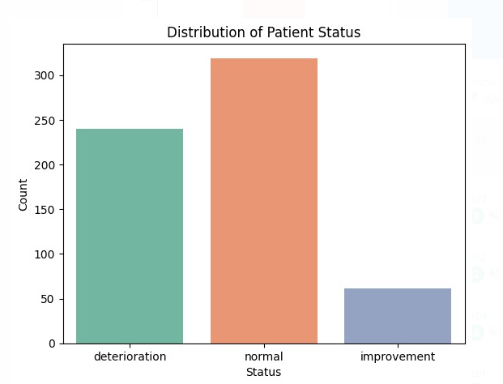
Exploration & Baseline
Exploration
Label distribution:
Normal: 60%
Improvement: 25%
Deterioration: 15%
Vitals (mean ± std):
HR: 74 ± 15 bpm
SpO₂: 96 ± 2 %
Temp: 36.8 ± 0.4 °C
Age:
Mean: 55 ± 18 yrs, peak 30–60
Text insights
WordCloud tokens: “pain”, “breath”, “chest”, “tired”
Baseline
Features
Standardized vitals
TF-IDF(500 features) on patient complaints
Model
Logistic Regression (class_weight=balanced)
Evaluation
Stratified 5-fold CV
Accuracy = 0.68
Macro-F1 = 0.53
Takeaway
Baseline provides a simple reference—shows clear room for improvement with advanced fusion models.

Slide 7
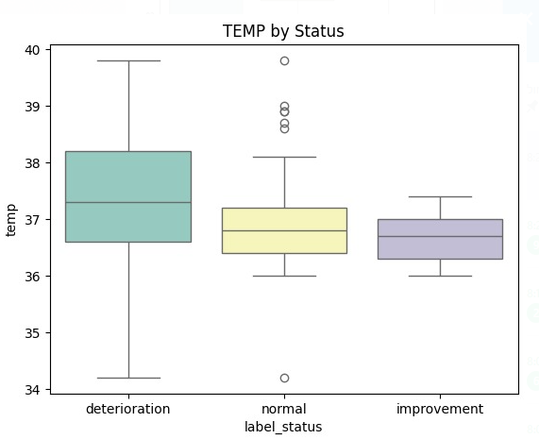
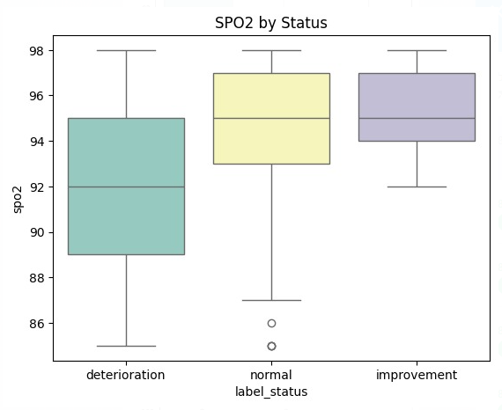
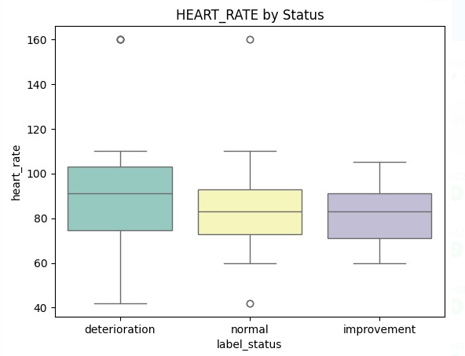
Exploration & Baseline

Slide 8
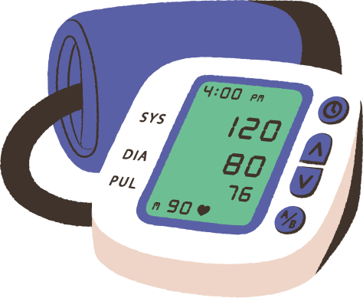


Insights & Recommendations
Free-text patient reports provide valuable yet noisy information
• EDA revealed variability in report length and phrasing.
• Introducing more realistic linguistic noise and structure in synthetic data may improve generalization
Traditional models outperformed BERT in this setting
• Random Forest + TF-IDF + vitals outperformed the BERT-based model (Macro-F1 ~0.49 vs. ~0.40).
• Likely due to limited dataset size and class imbalance.
Class imbalance negatively affects model performance
• Rare classes such as Deterioration saw notably lower F1 scores.
• Applying class weights improved results marginally; data augmentation may be necessary.
Current multimodal fusion is too simplistic
• Simple feature concatenation was used.
• Future models should explore more advanced fusion techniques: cross-attention, co-training,
or learned joint representations.
Multitask learning could boost both accuracy and relevance
• Simultaneous prediction of both status and recommended_action may better reflect clinical reasoning.
• Could also improve efficiency and robustness in deployment scenarios.

Slide 9
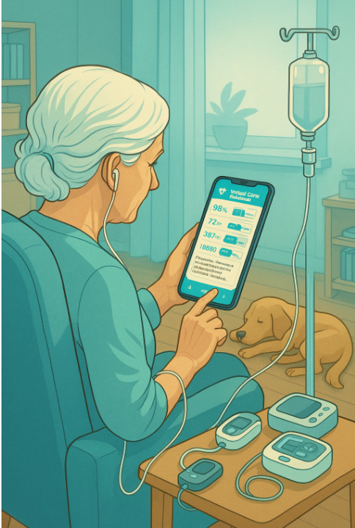
Thank You
for listening

